Slide 1
MnasNet: Platform-Aware Neural Architecture Search for Mobile

Slide 2
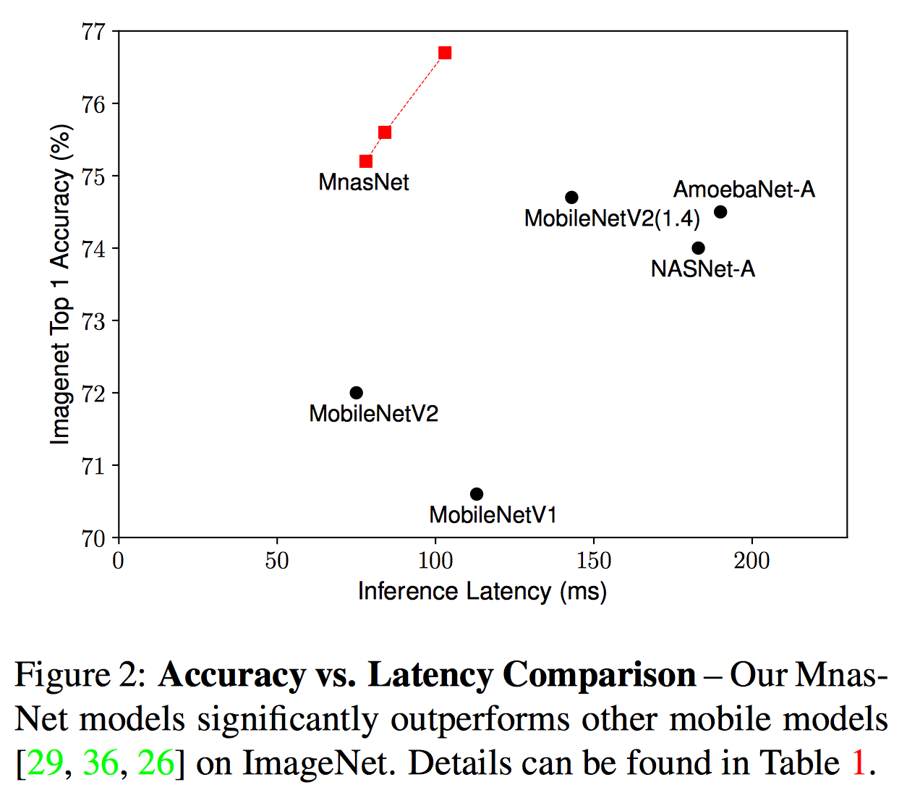
Contribution
Previous work: use FLOPS to approximate inference latency, we directly measure the real-world latency by executing the model on real mobile devices.
An automated mobile neural architecture search (MNAS) approach, which explicitly incorporate model latency into the main objective that achieves a good trade-off between accuracy and latency.
A novel factorized hierarchical search space that encourages layer diversity throughout the network.
A new state-of-the-art accuracy on both ImageNet classiﬁcation and COCO object detection under typical mobile latency constraints.
Previous automated approaches mainly search for a few types of cells and then repeatedly stack the same cells through the network. which precludes layer diversity that is important for computational efﬁciency.

Slide 3
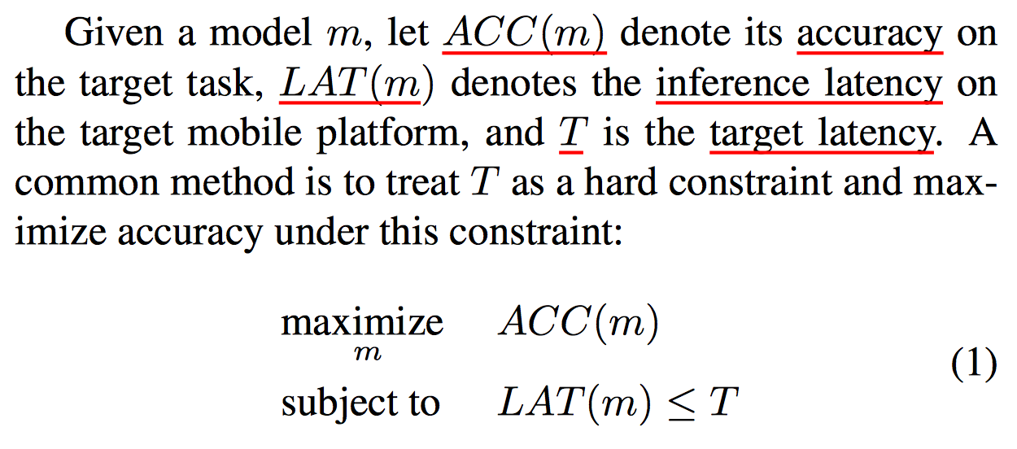
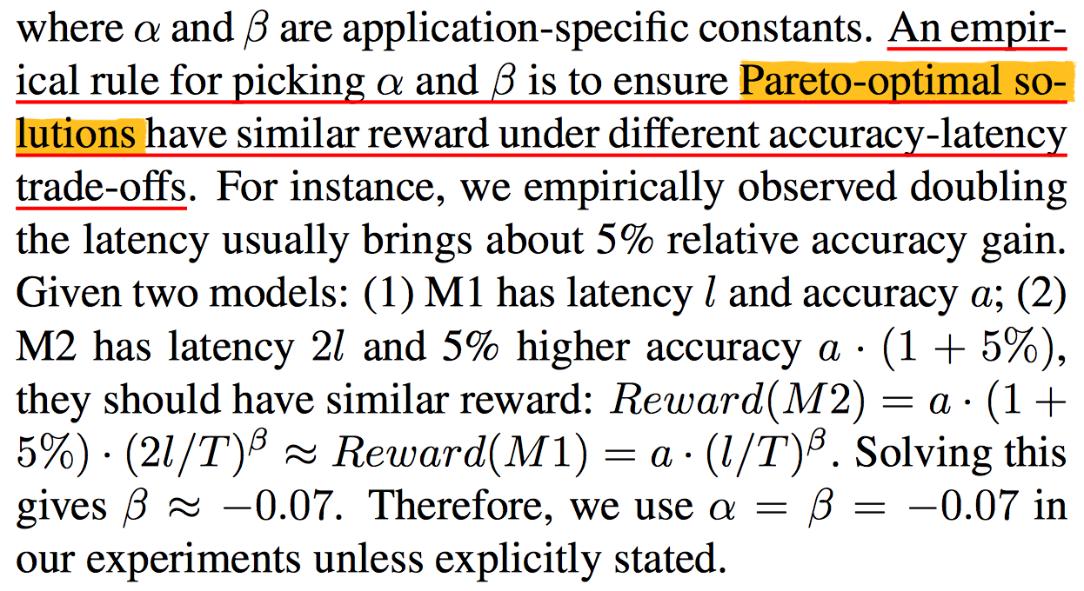
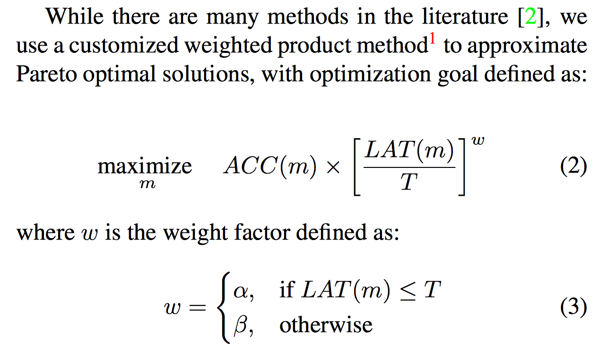
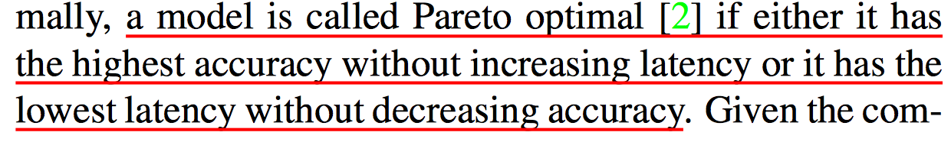
Multi-objective search
CNN models with both high accuracy and low inference latency

Slide 4
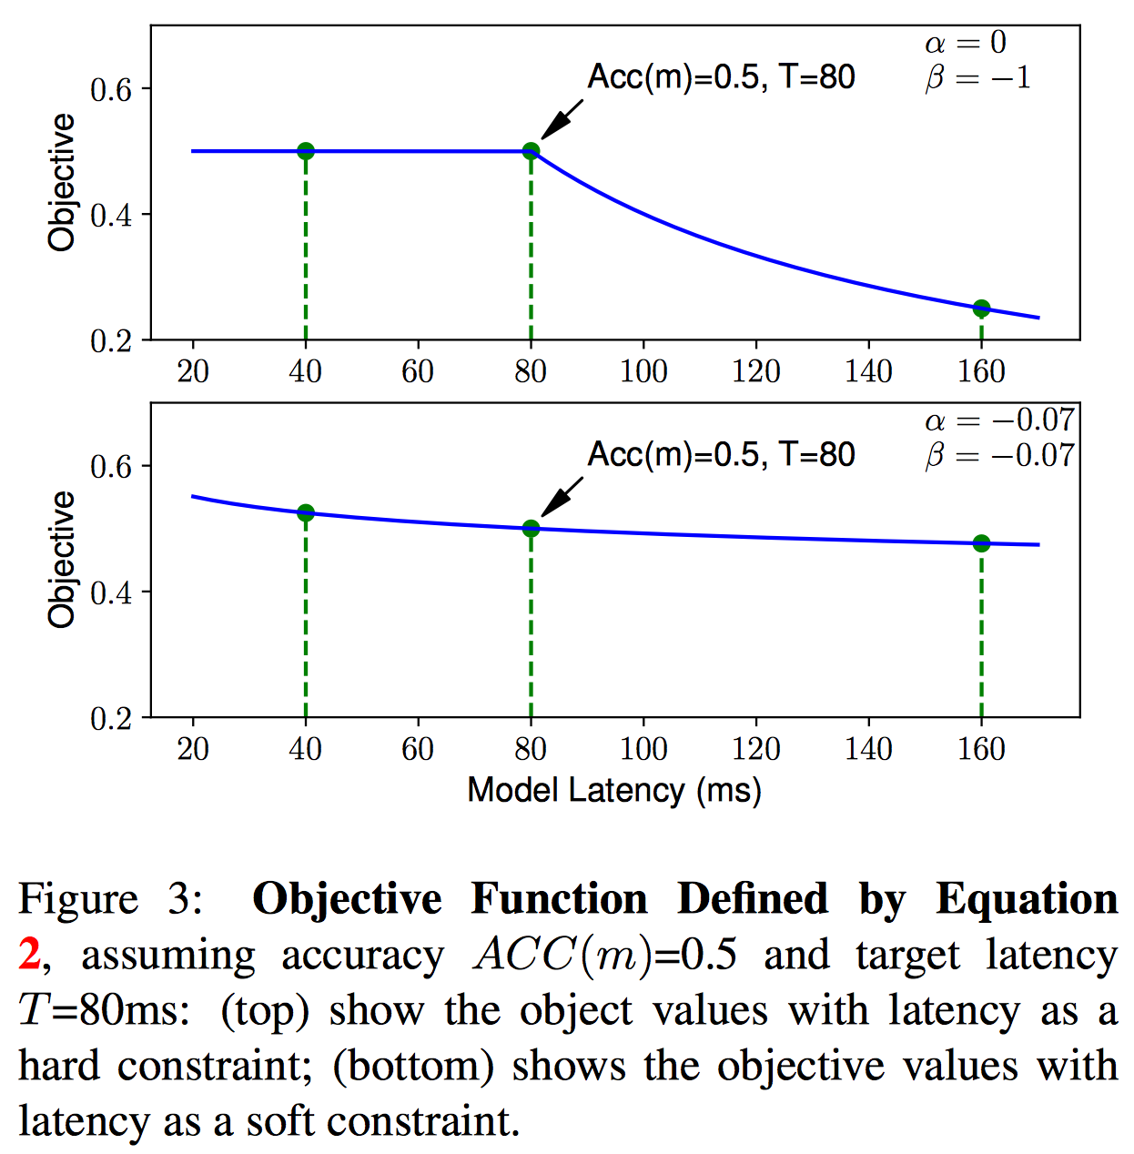
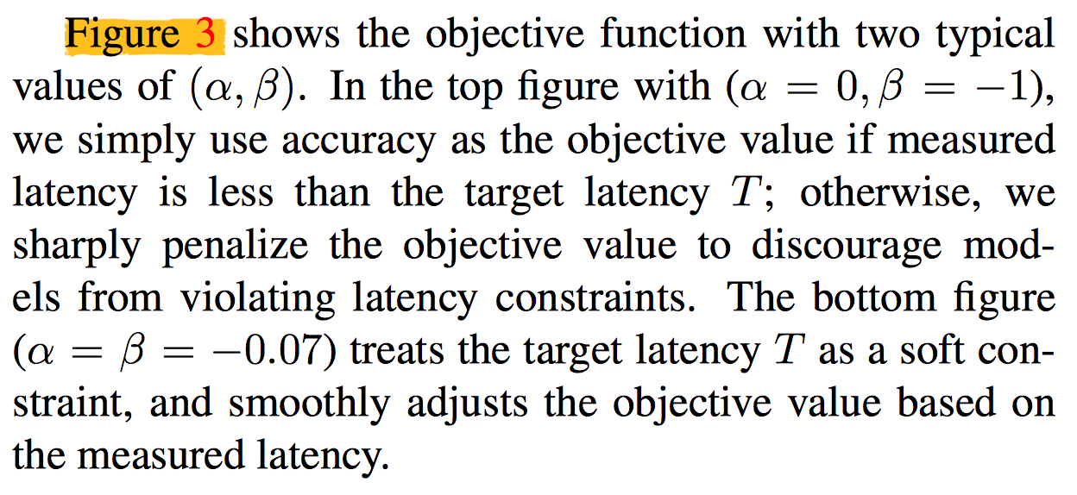
Multi-Objective Search

Slide 5
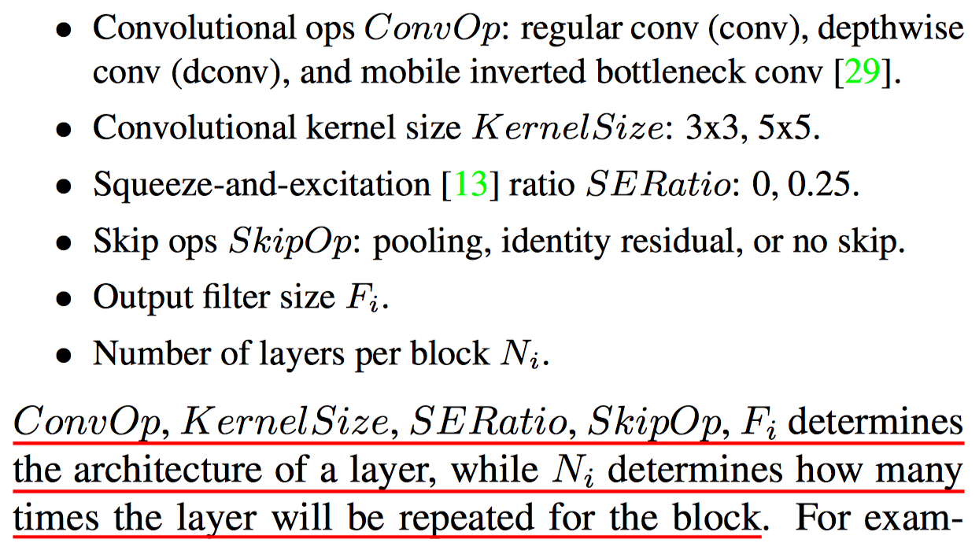
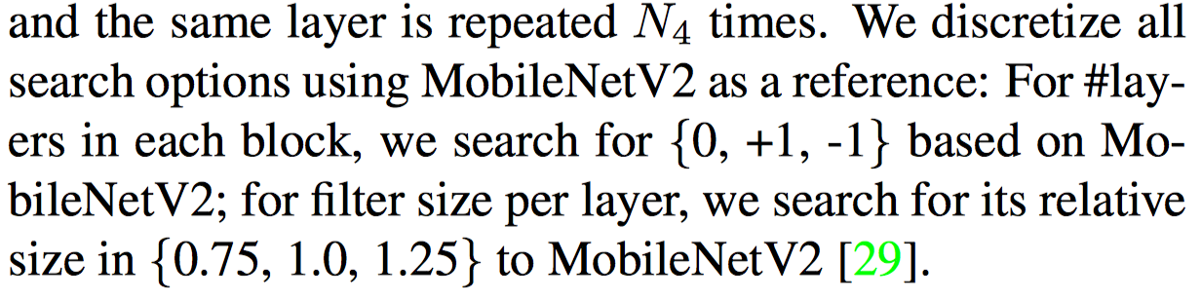
Factorized Hierarchical Search Space
Factorizes a CNN model into unique blocks and then searches for the operations and connections
per block separately, thus allowing different layer architectures in different blocks

Slide 6
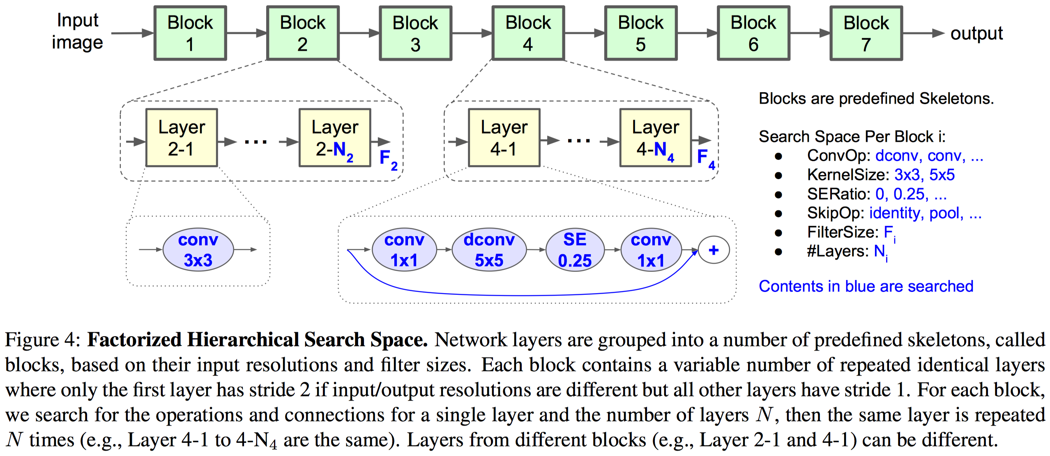
Factorized Hierarchical Search Space

Slide 7
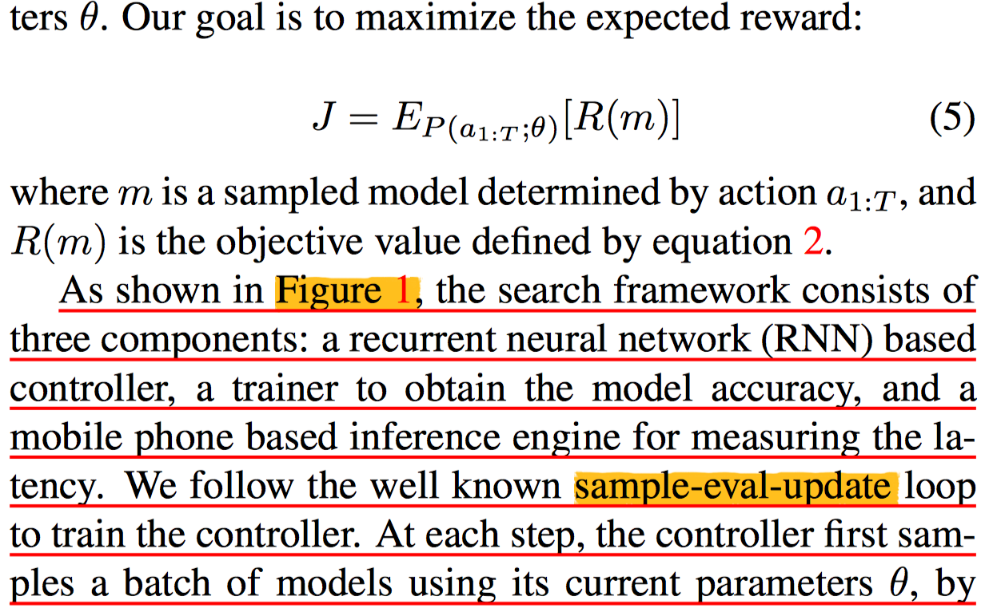
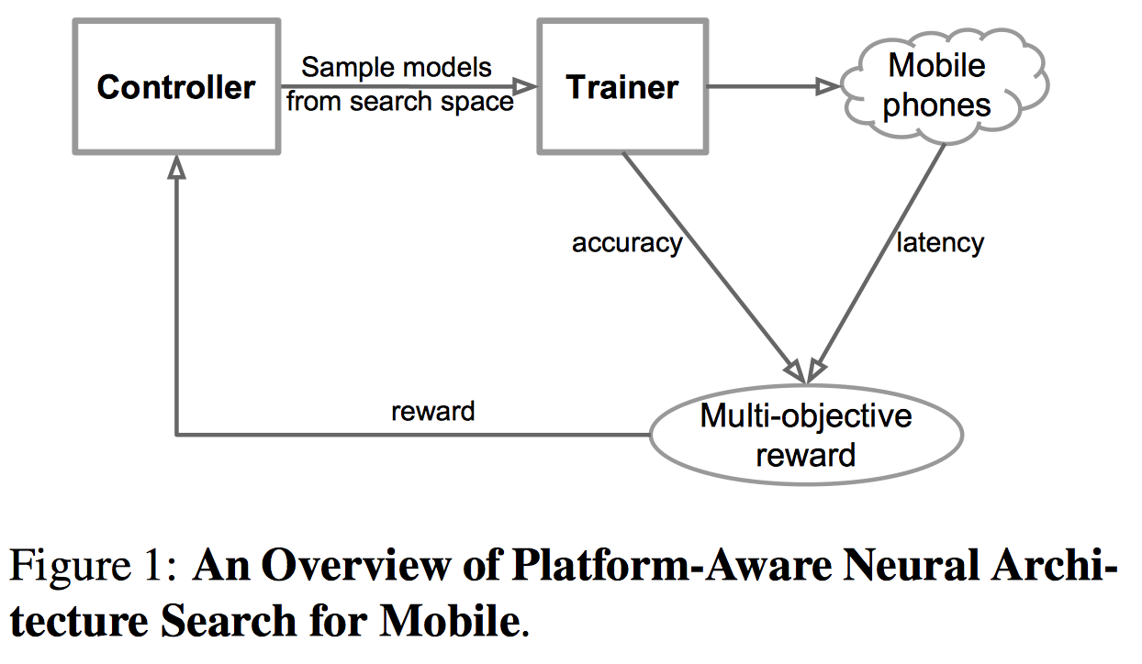
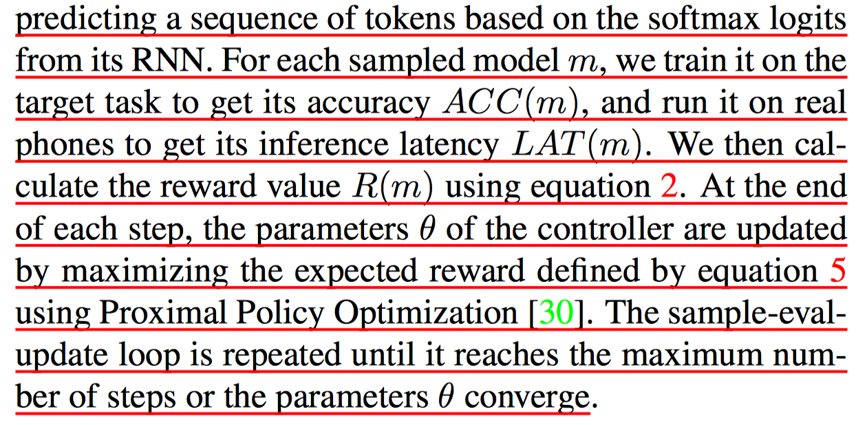
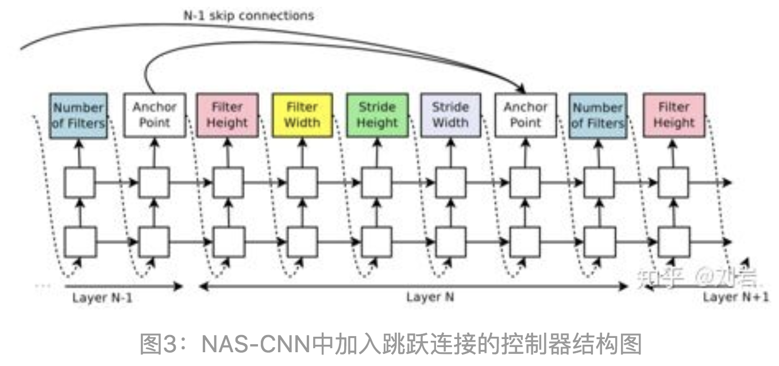
Search Algorithm

Slide 8
Experimental Setup
Perform architecture search on the ImageNet training set with fewer training steps (5 epochs).
Randomly selected 50K images from the training set as the ﬁxed validation set.
Controller samples about 8K models during architecture search, but only 15 top-performing models are transferred to the full ImageNet and only 1 model is transferred to COCO.

Slide 9
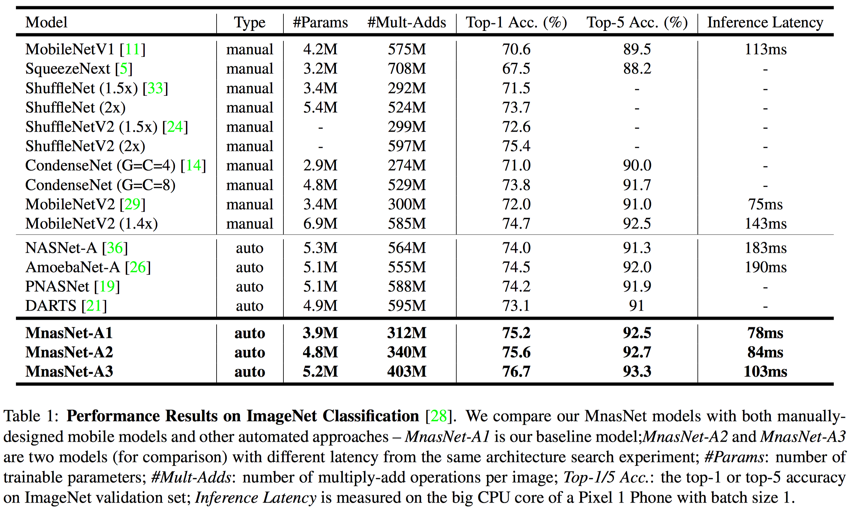
ImageNet Classiﬁcation Performance
Target latency as T = 75ms, similar to MobileNetV2, and use Equation 2 with α=β=-0.07

Slide 10
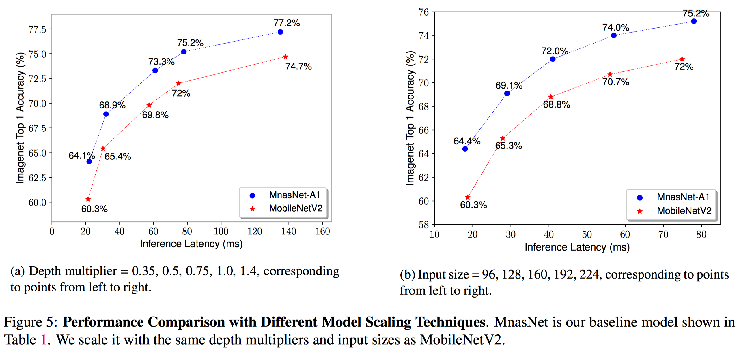
Model Scaling Performance
MnasNet model consistently achieves better accuracy than MobileNetV2 for each depth multiplier.
MnasNet is also robust to input size changes and consistently outperforms MobileNetV2.

Slide 11
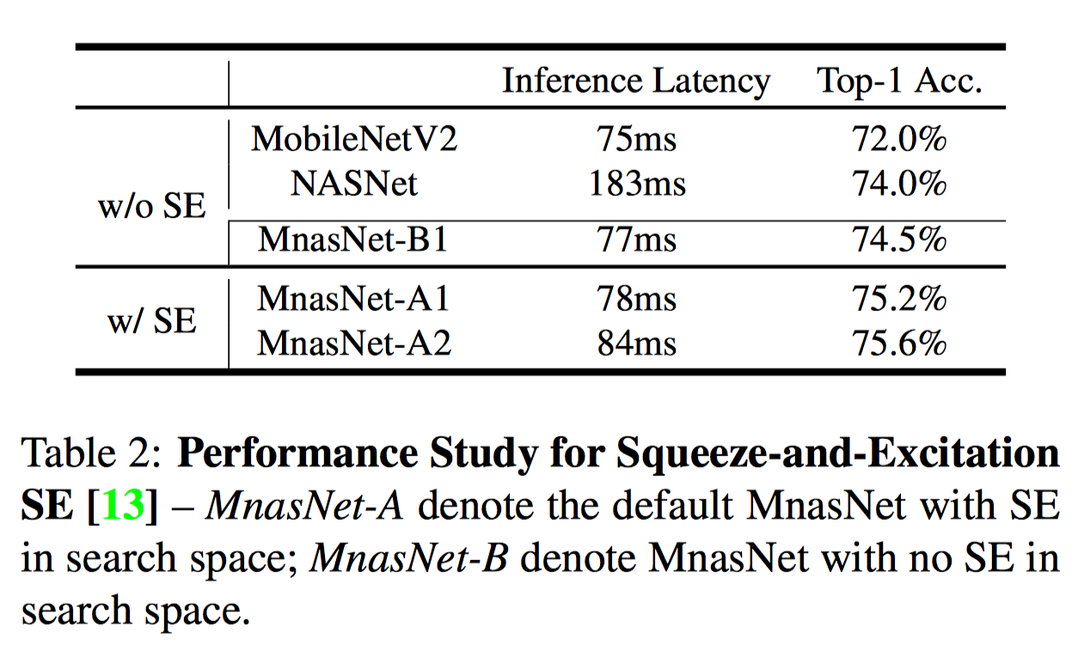
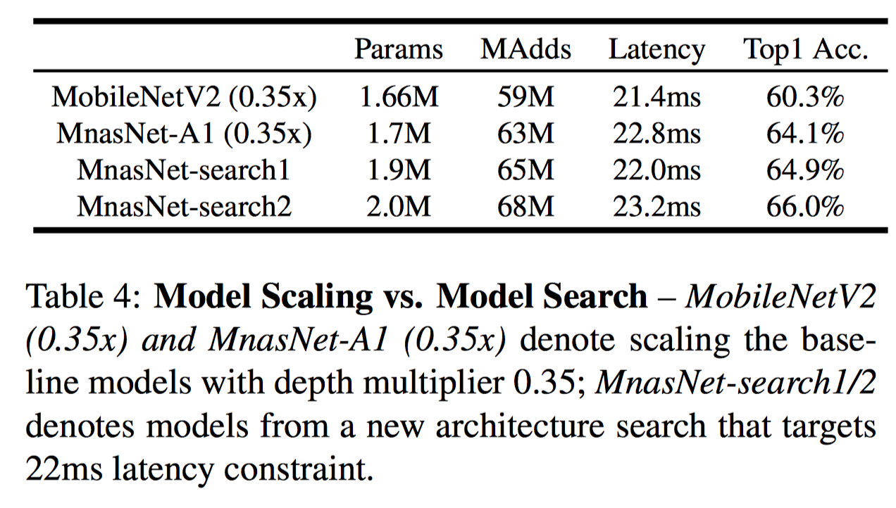

Slide 12
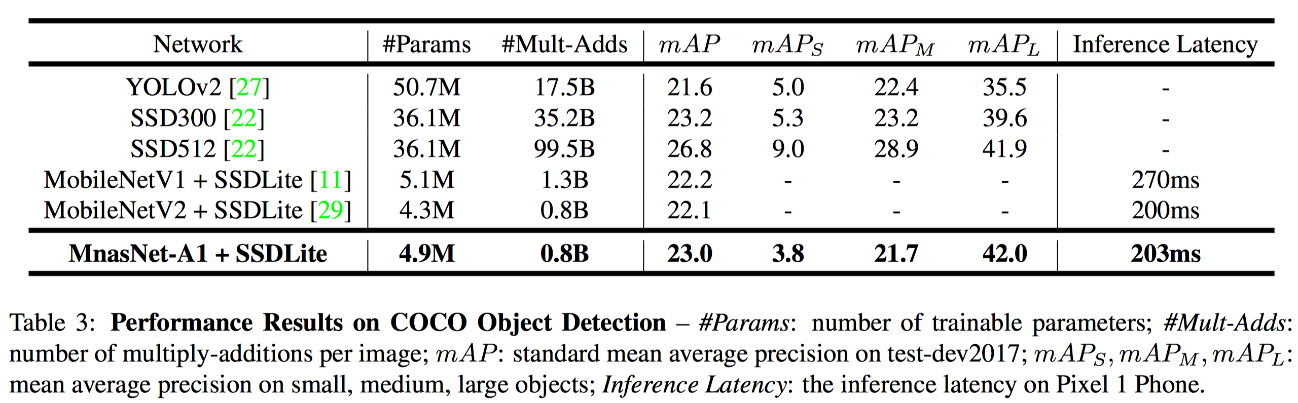
COCO Object Detection Performance

Slide 13
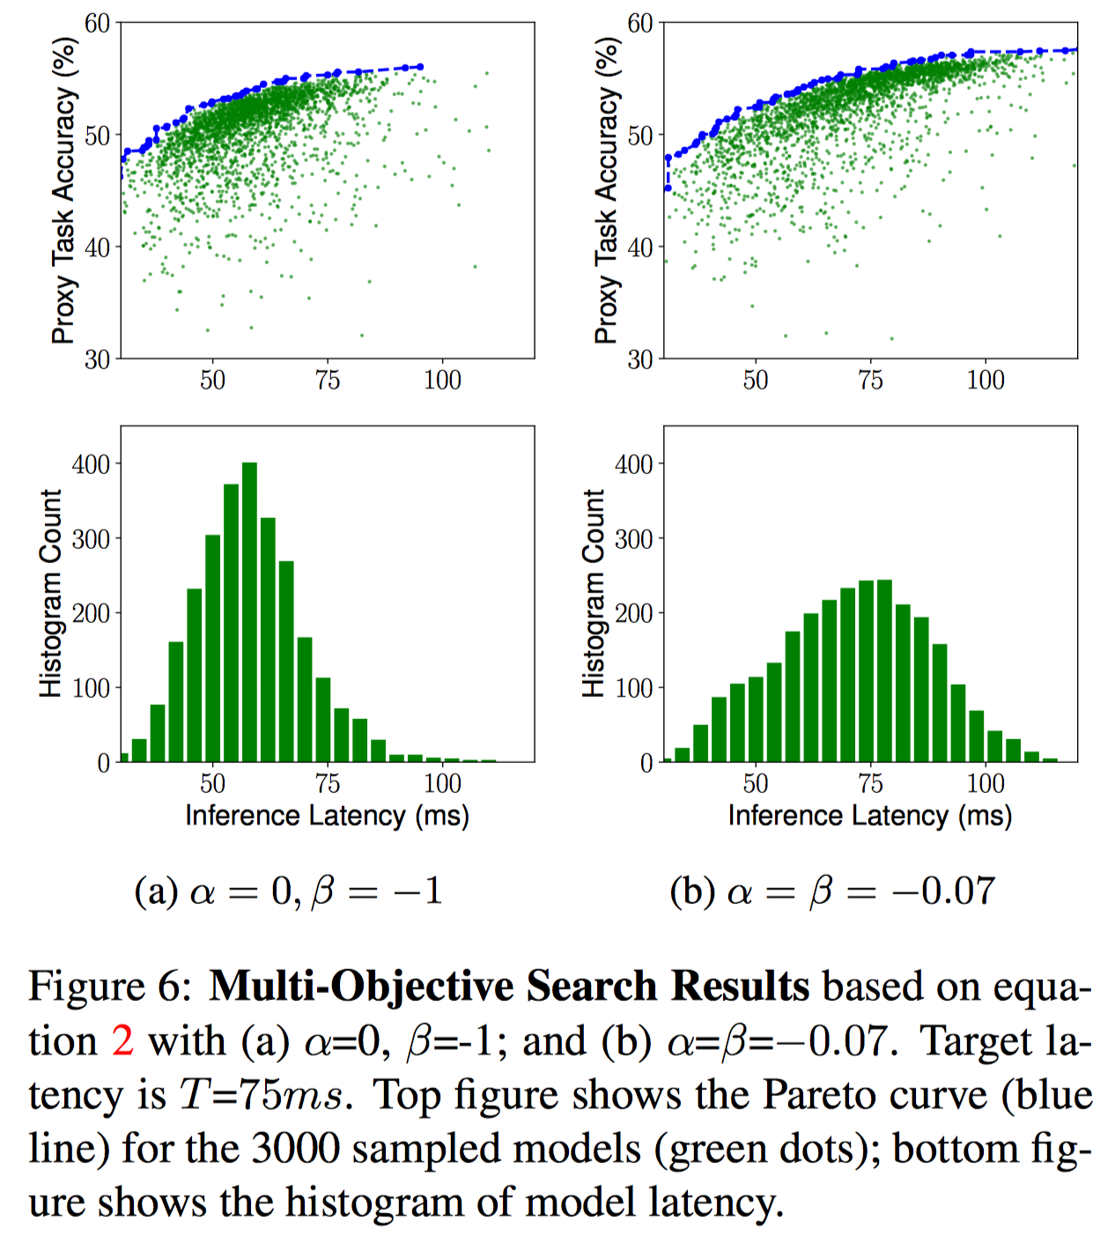
Soft vs. Hard Latency Constraint
When α = 0, β = −1, the latency is treated as a hard constraint, so the controller tends to focus more on faster models to avoid the latency penalty.
On the other hand, by setting α = β = −0.07, the controller treats the target latency as a soft constraint and tries to search for models across a wider latency range.

Slide 14
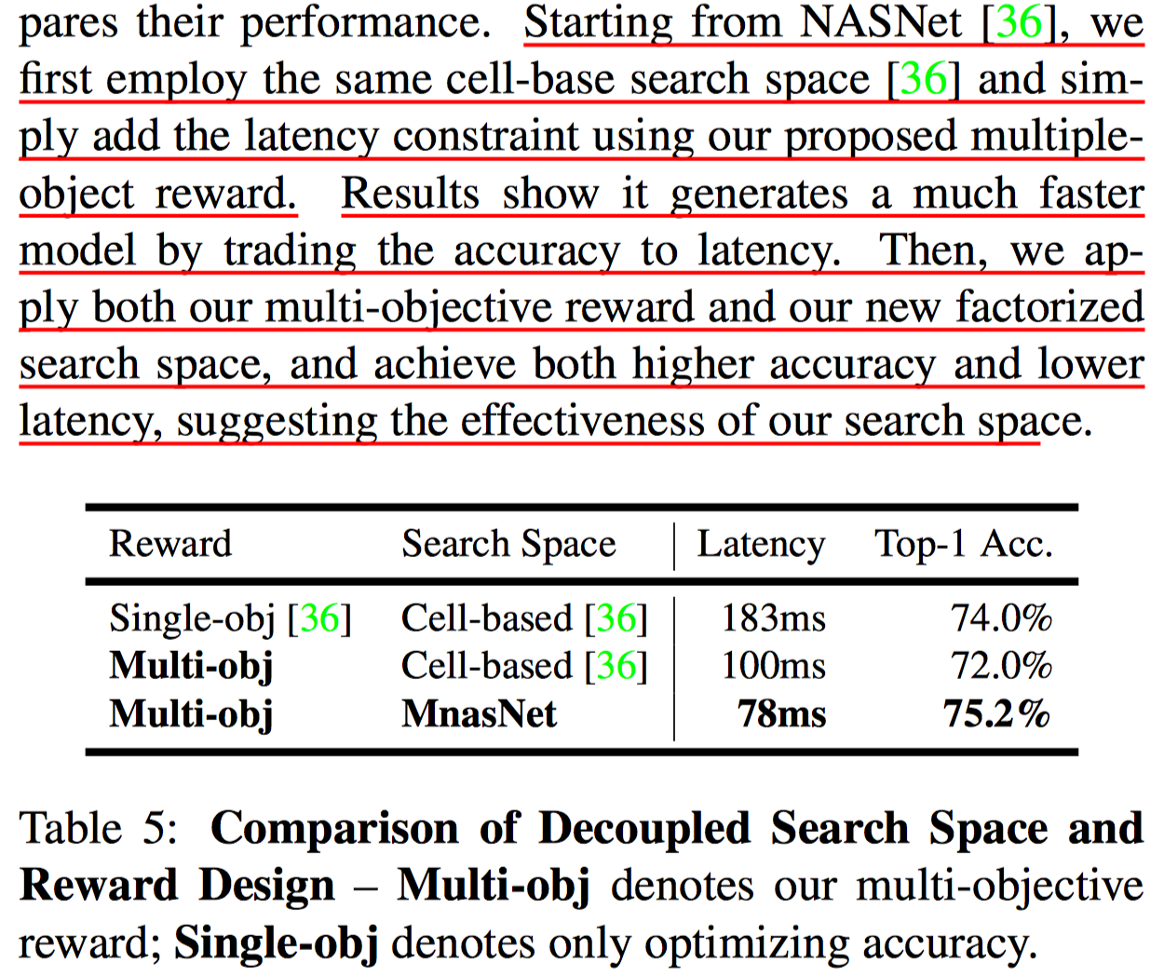
Disentangling Search Space and Reward

Slide 15
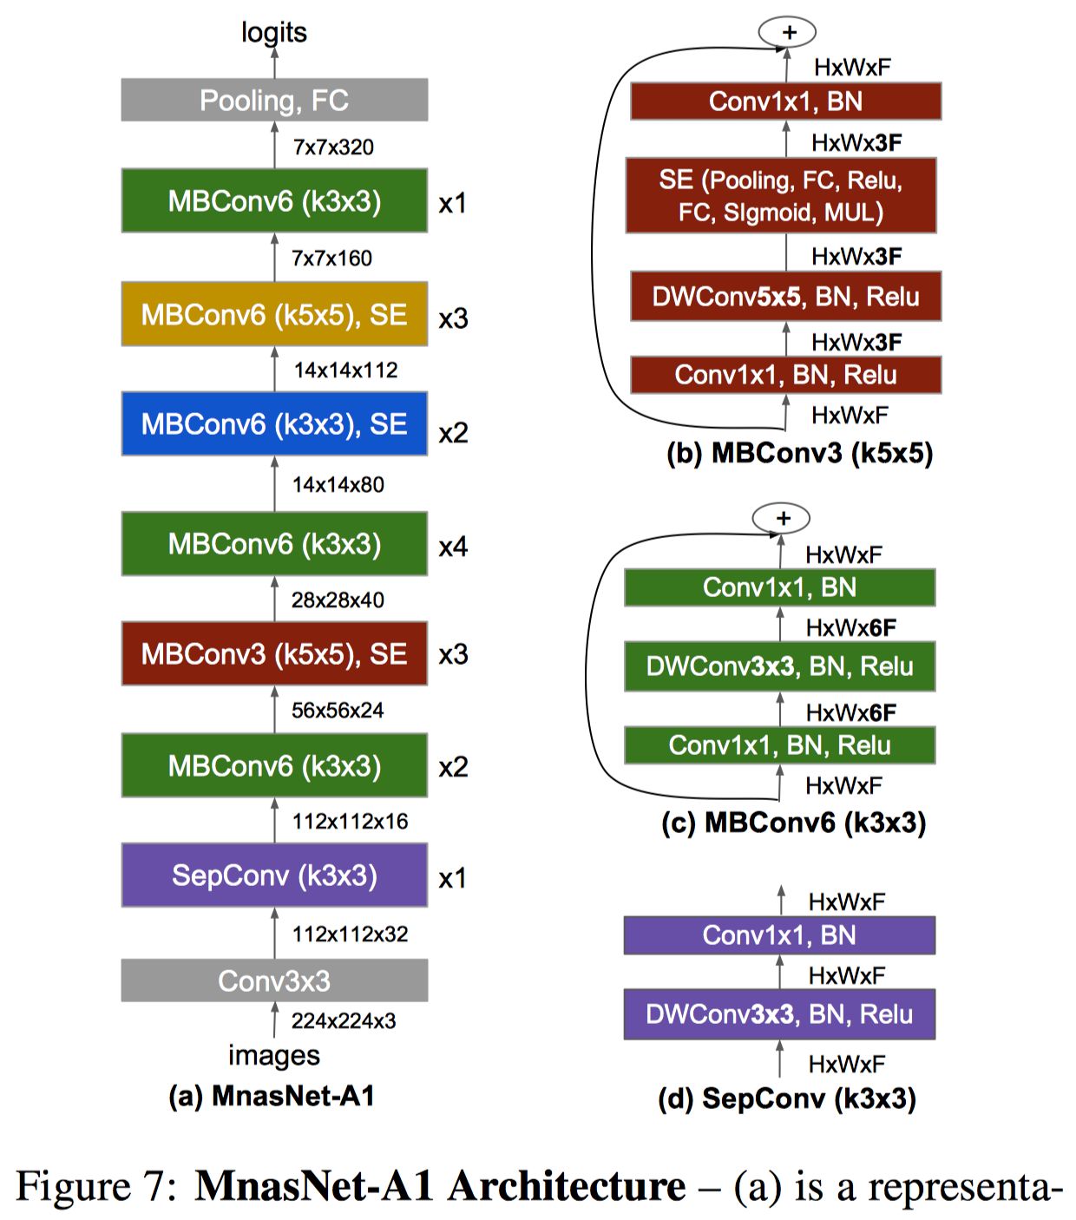
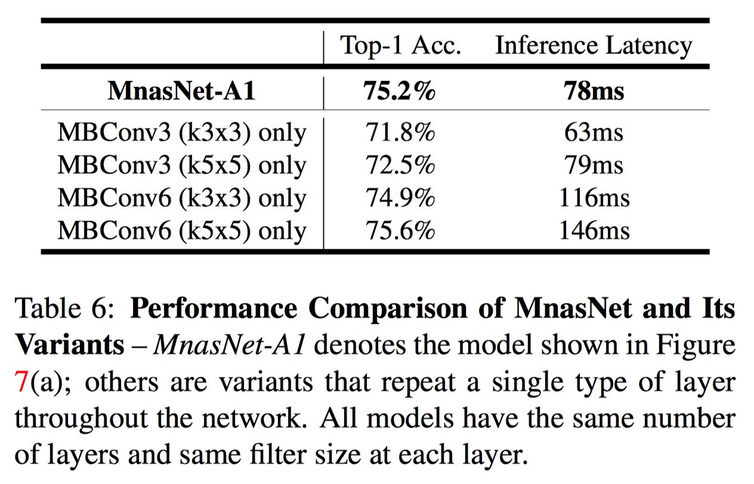
MnasNet Architecture and Layer Diversity
Study the impact of layer diversity

